Slide 1
Arrays: computing with many numbers

Slide 2
Some perspective
We have so far (mostly) looked at what we can do with single numbers (and functions that return single numbers).
Things can get much more interesting once we allow not just one, but many numbers together.
It is natural to view an array of numbers as one object with its own rules.
The simplest such set of rules is that of a vector.

Slide 3
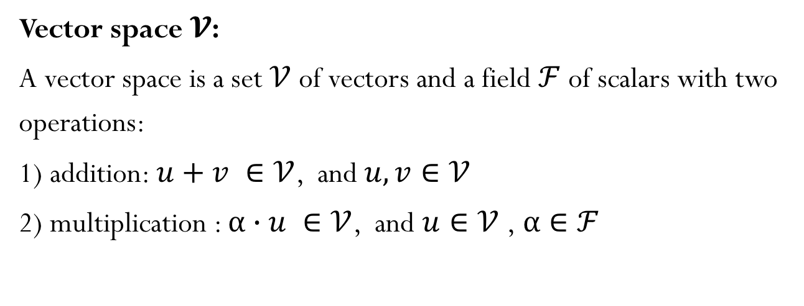
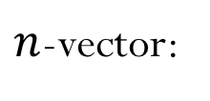
Vectors
A vector is an element of a Vector Space
$n$-vector:
Vector space $𝓥$:
A vector space is a set $𝒱$ of vectors and a field $ℱ$of scalars with two operations:
1) addition: $u+v ∈𝒱$, and $u,v∈𝒱$
2) multiplication : $α∙u ∈𝒱$, and $u∈𝒱$ ,$α∈ℱ$

Slide 4
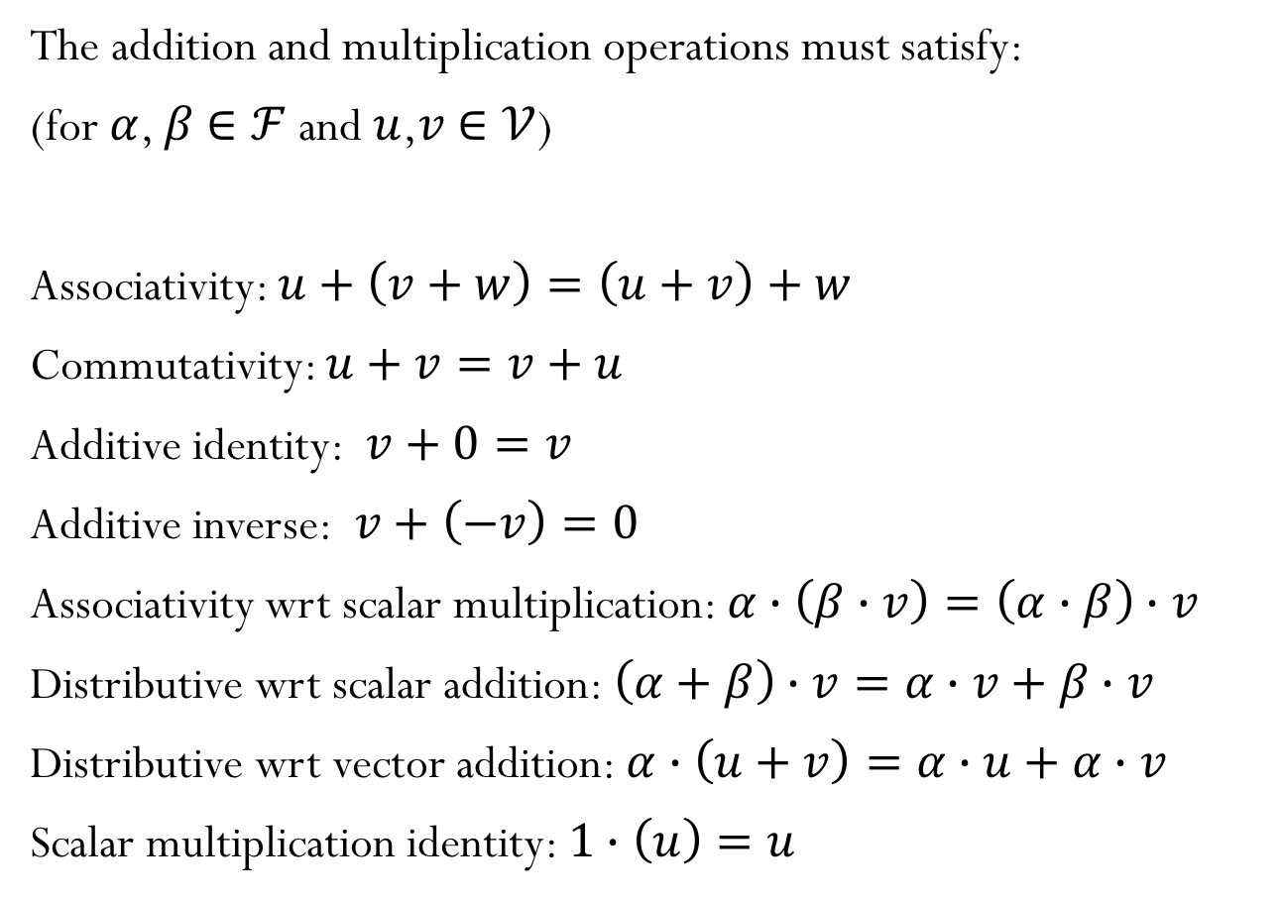
Vector Space
The addition and multiplication operations must satisfy:
(for $α$, $β$ $∈ℱ$and $u$,$v$ $∈𝒱$)
Associativity: $u+\left(v+w\right)=\left(u+v\right)+w$
Commutativity: $u+v=v+u$
Additive identity: $v+0=v$
Additive inverse: $v+\left(−v\right)=0$
Associativity wrt scalar multiplication: $α∙\left(β∙v\right)=\left(α∙β\right)∙v$
Distributive wrt scalar addition: $\left(α+β\right)∙v=α∙v+β∙v$
Distributive wrt vector addition: $α∙\left(u+v\right)=α∙u+α∙v$
Scalar multiplication identity: $1∙\left(u\right)=u$

Slide 5
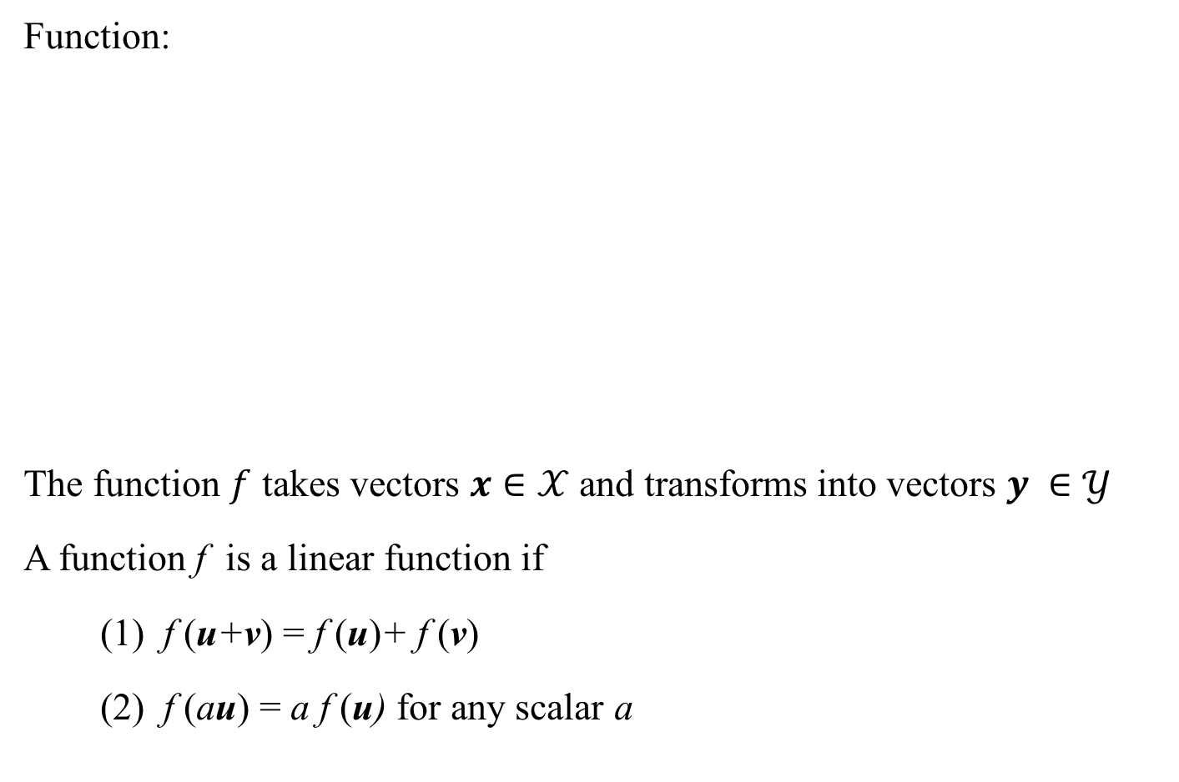
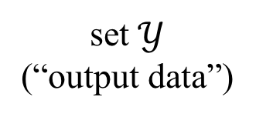
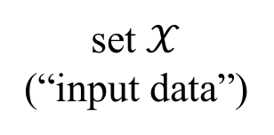
Linear Functions
Function:
The function $f$ takes vectors $x∈𝒳$ and transforms into vectors $y ∈𝒴$
A function f is a linear function if
(1) f (u+v) = f (u)+ f (v)
(2) f (au) = a f (u) for any scalar a
set $𝒳$
(“input data”)
set $𝒴$
(“output data”)

Slide 6
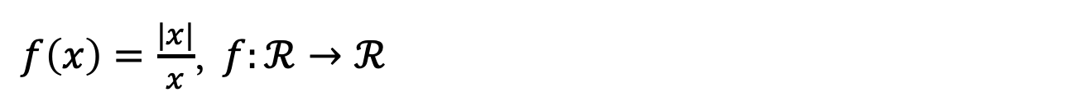
Linear functions?
$f\left(x\right)=\frac{|x|}{x}$, $f:ℛ→ℛ$
$f\left(x\right)=a x+b$, $f:ℛ→ℛ$, $a,b∈ℛ$ and $a,b≠0$

Slide 7
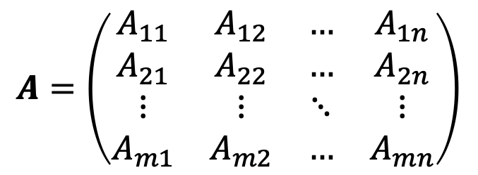
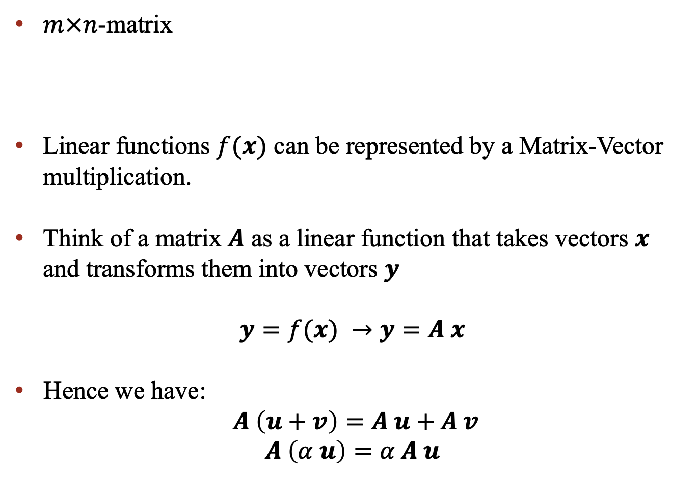
Matrices
$$A=\left(\begin{matrix}A_{11} & A_{12} & … & A_{1n} \\ A_{21} & A_{22} & … & A_{2n} \\ ⋮ & ⋮ & ⋱ & ⋮ \\ A_{m1} & A_{m2} & … & A_{mn}\end{matrix}\right)$$
$m×n$-matrix
Linear functions $f(x)$ can be represented by a Matrix-Vector multiplication.
Think of a matrix $A$ as a linear function that takes vectors $x$ and transforms them into vectors $y$
$y=f(x)$ $→y=A x$
Hence we have:
$A \left(u+v\right)=A u+A v$
$$A \left(α u\right)=α A u$$

Slide 8
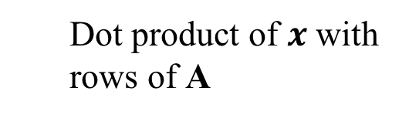
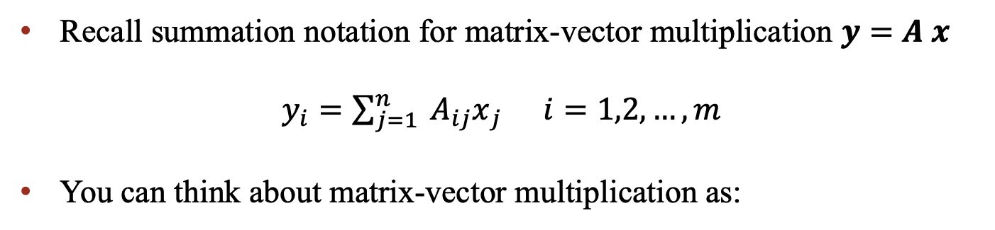
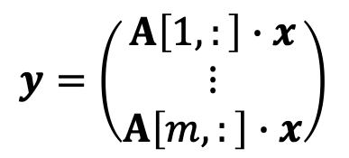
Matrix-Vector multiplication
Recall summation notation for matrix-vector multiplication $y=A x$
$y_{i}=\sum_{j=1}^{n}{{ A_{ij}x}_{j}}$ $i=1,2,…,m$
You can think about matrix-vector multiplication as:
Linear combination of column vectors of A
$$y={ x}_{1} A\left[:,1\right]+{ x}_{2} A\left[:,2\right]+…+{ x}_{n} A[:,n]$$
$$y=\left(\begin{matrix}A\left[1,:\right]∙x \\ ⋮ \\ A\left[m,:\right]∙x\end{matrix}\right)$$
Dot product of $x$ with rows of A

Slide 9
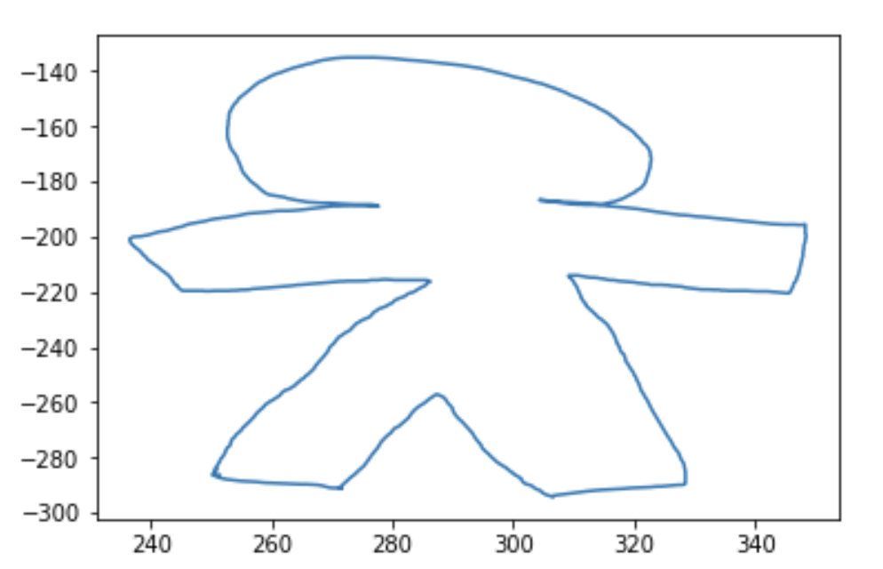
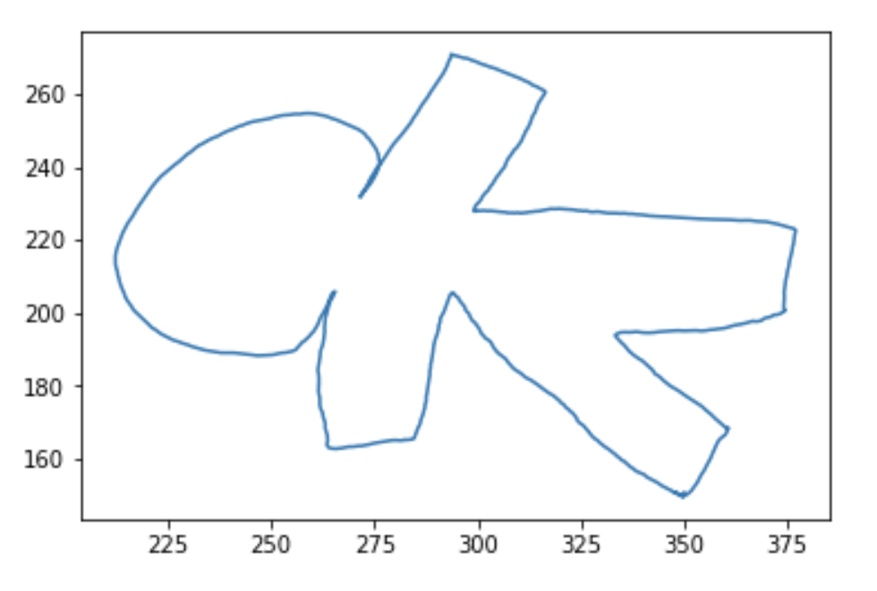
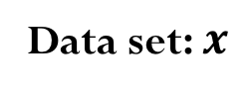
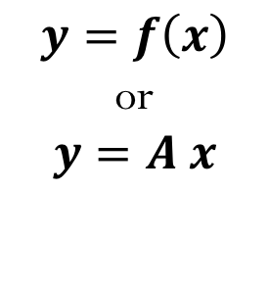
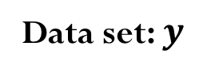
Matrices operating on data
Data set: $x$
Data set: $y$
Rotation
$$y=f\left(x\right)$$
or
$$y=A x$$

Slide 10
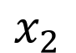
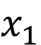
Example: Shear operator
Matrix-vector multiplication for each vector (point representation in 2D):
$$x_{2}$$
$$x_{1}$$

Slide 11
Matrices as operators
Data: grid of 2D points
Transform the data using matrix multiply
What can matrices do?
Shear
Rotate
Scale
Reflect
Can they translate?

Slide 12
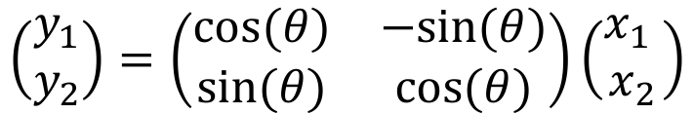
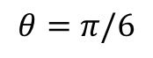
Rotation operator
$$\left(\begin{matrix}y_{1} \\ y_{2}\end{matrix}\right)=\left(\begin{matrix}cos⁡(θ) & −sin⁡(θ) \\ sin⁡(θ) & cos⁡(θ)\end{matrix}\right)\left(\begin{matrix}x_{1} \\ x_{2}\end{matrix}\right)$$
$$θ=π/6$$

Slide 13
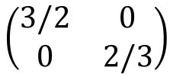
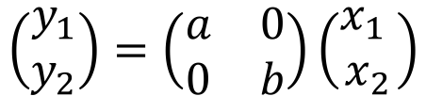
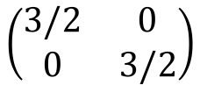
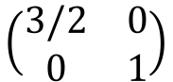
Scale operator
$$\left(\begin{matrix}y_{1} \\ y_{2}\end{matrix}\right)=\left(\begin{matrix}a & 0 \\ 0 & b\end{matrix}\right)\left(\begin{matrix}x_{1} \\ x_{2}\end{matrix}\right)$$
$$\left(\begin{matrix}3/2 & 0 \\ 0 & 3/2\end{matrix}\right)$$
$$\left(\begin{matrix}3/2 & 0 \\ 0 & 1\end{matrix}\right)$$
$$\left(\begin{matrix}3/2 & 0 \\ 0 & 2/3\end{matrix}\right)$$

Slide 14
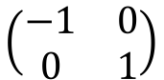
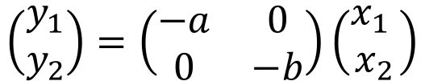
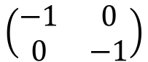
Reflection operator
$$\left(\begin{matrix}y_{1} \\ y_{2}\end{matrix}\right)=\left(\begin{matrix}−a & 0 \\ 0 & −b\end{matrix}\right)\left(\begin{matrix}x_{1} \\ x_{2}\end{matrix}\right)$$
$$\left(\begin{matrix}−1 & 0 \\ 0 & 1\end{matrix}\right)$$
$$\left(\begin{matrix}−1 & 0 \\ 0 & −1\end{matrix}\right)$$
Reflect about y-axis
Reflect about x and y-axis

Slide 15
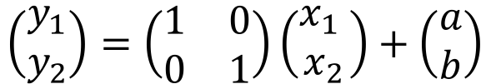
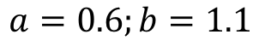
Translation (shift)
$$\left(\begin{matrix}y_{1} \\ y_{2}\end{matrix}\right)=\left(\begin{matrix}1 & 0 \\ 0 & 1\end{matrix}\right)\left(\begin{matrix}x_{1} \\ x_{2}\end{matrix}\right)+\left(\begin{matrix}a \\ b\end{matrix}\right)$$
$$a=0.6;b=1.1$$

Slide 16
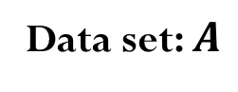
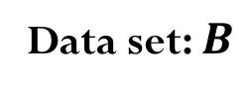
Matrices operating on data
Data set: $A$
Data set: $B$
Rotation

Slide 17
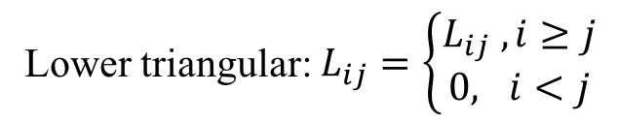
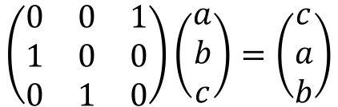
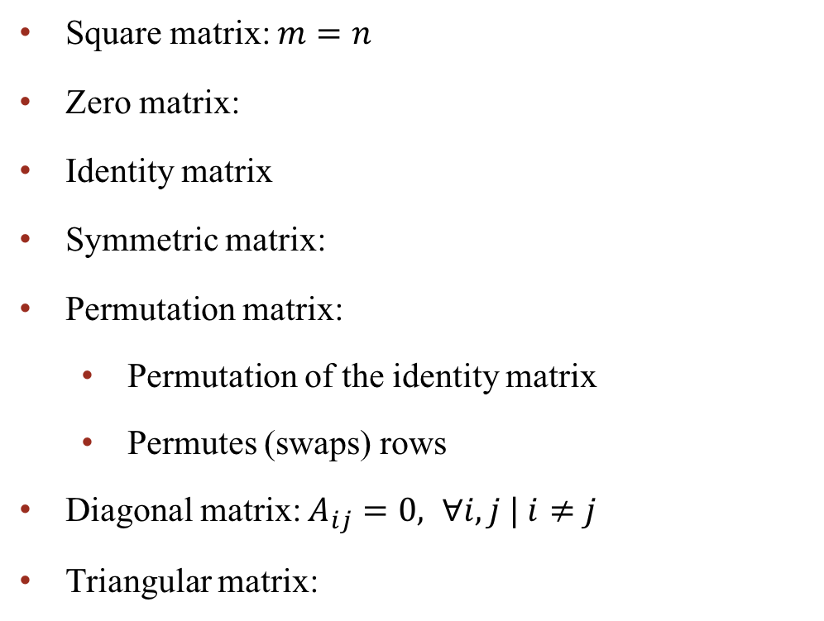
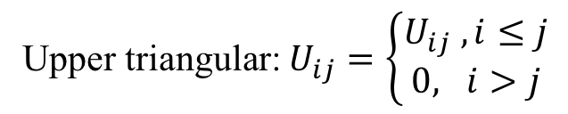
Notation and special matrices
Square matrix: $m=n$
Zero matrix:
Identity matrix
Symmetric matrix:
Permutation matrix:
Permutation of the identity matrix
Permutes (swaps) rows
Diagonal matrix: $A_{ij}=0, ∀i,j | i≠j$
Triangular matrix:
$$\left(\begin{matrix}0 & 0 & 1 \\ 1 & 0 & 0 \\ 0 & 1 & 0\end{matrix}\right)\left(\begin{matrix}a \\ b \\ c\end{matrix}\right)=\left(\begin{matrix}c \\ a \\ b\end{matrix}\right)$$
Lower triangular: $L_{ij}=\left\{\begin{matrix}L_{ij} , i≥j \\ 0, i<j\end{matrix}\right.$
Upper triangular: $U_{ij}=\left\{\begin{matrix}U_{ij} , i≤j \\ 0, i>j\end{matrix}\right.$

Slide 18
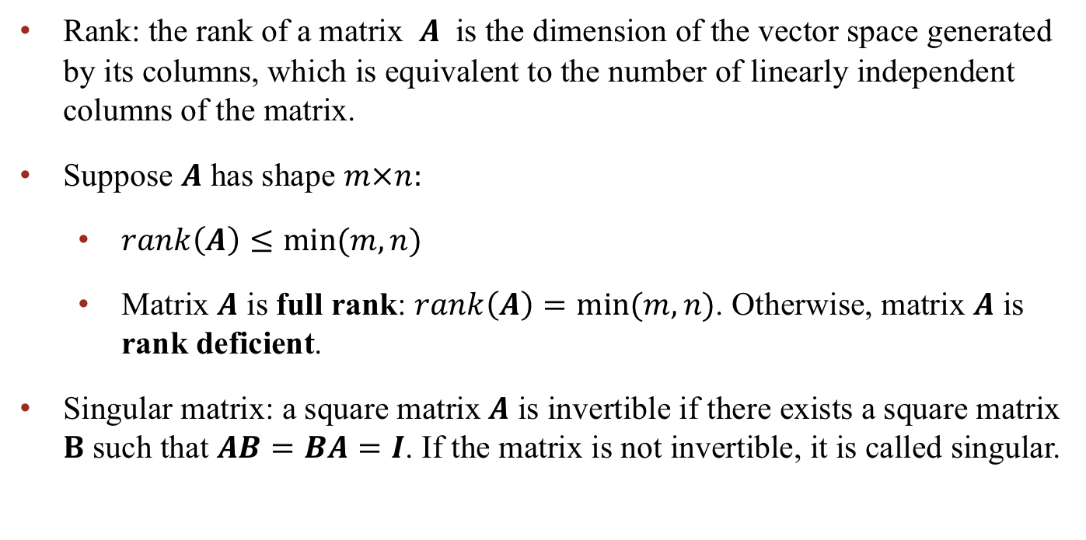
More about matrices
Rank: the rank of a matrix $A$ is the dimension of the vector space generated by its columns, which is equivalent to the number of linearly independent columns of the matrix.
Suppose $A$ has shape $m×n:$
$rank\left(A\right)≤min⁡(m,n)$
Matrix $A$ is full rank: $rank\left(A\right)=min⁡(m,n)$. Otherwise, matrix $A$ is rank deficient.
Singular matrix: a square matrix$A$ is invertible if there exists a square matrix $B$ such that $AB=BA=I$. If the matrix is not invertible, it is called singular.

Slide 19
Vector and Matrix Norms

Slide 20
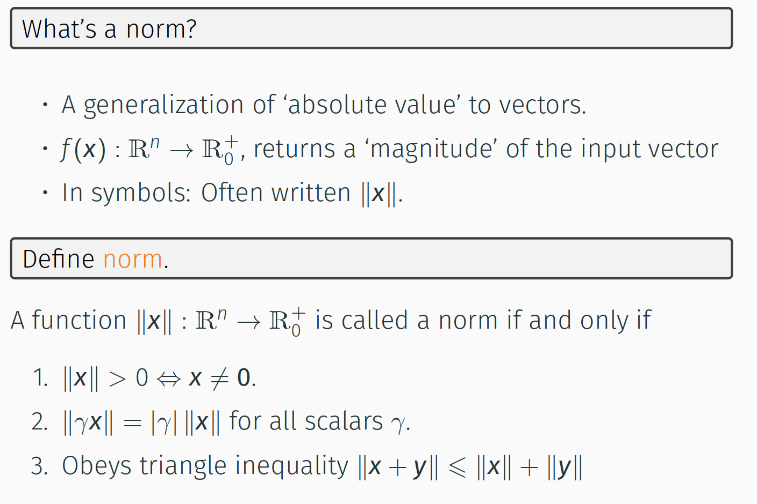
Norms

Slide 21
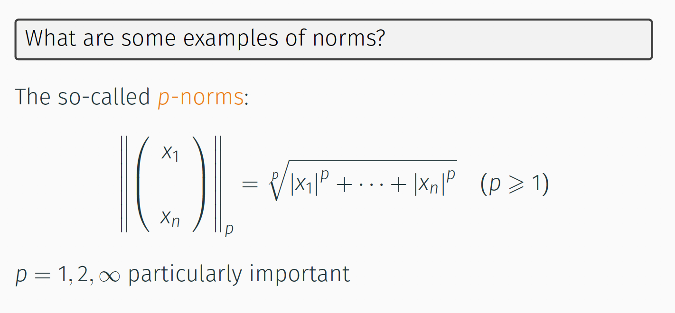
Demo “Vector Norms”
Example of Norms

Slide 22
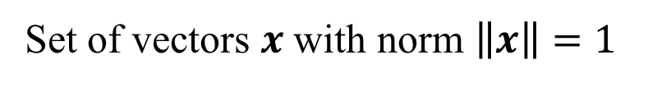
Unit Ball:
Set of vectors $x$ with norm $\left\|x\right\|=1$

Slide 23
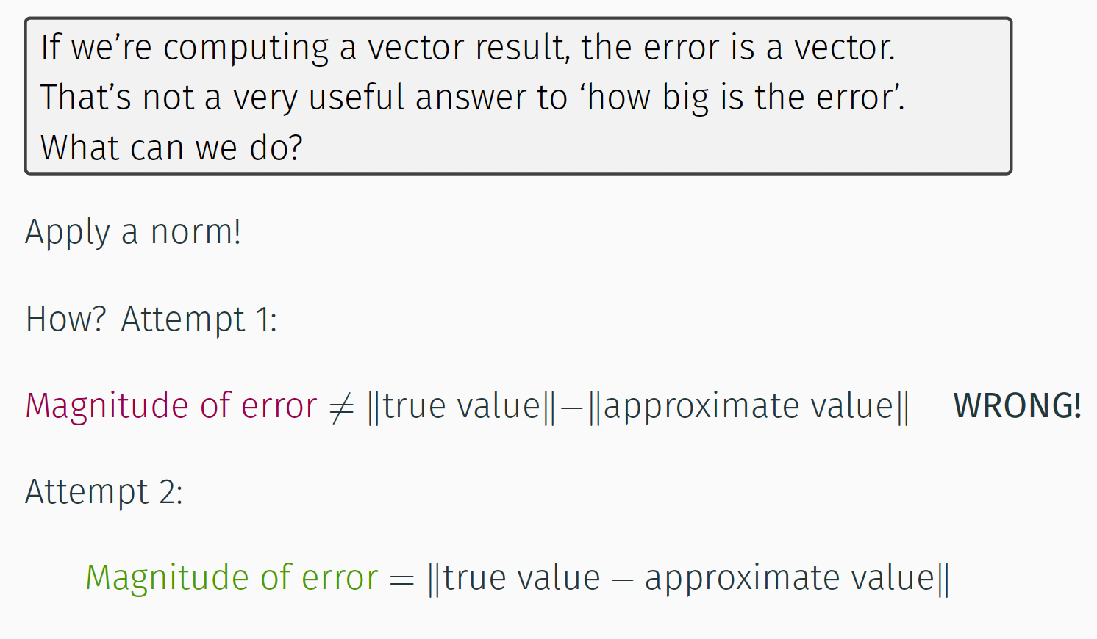
Norms and Errors

Slide 24
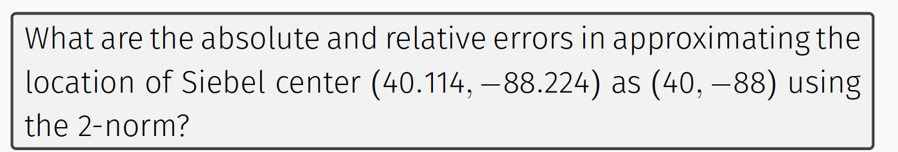
Absolute and Relative Errors
Notes:
C and A

Slide 25
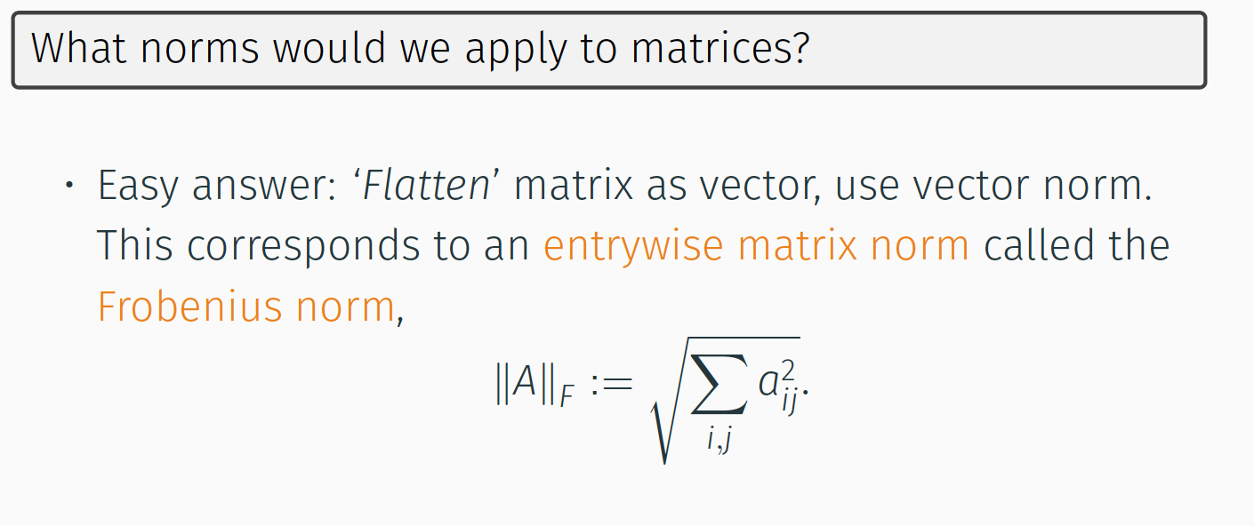
Matrix Norms

Slide 26
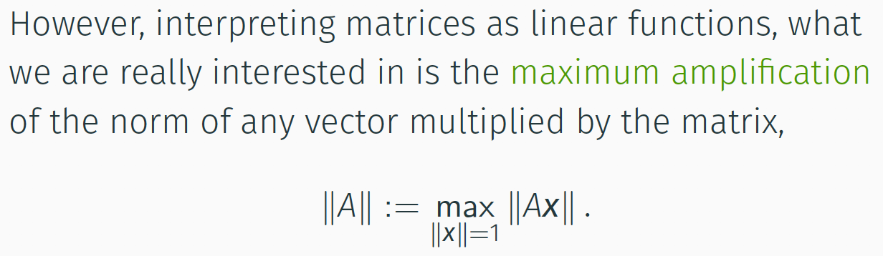
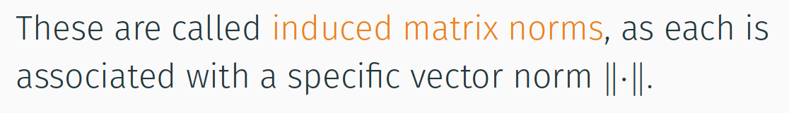
Matrix Norms

Slide 27
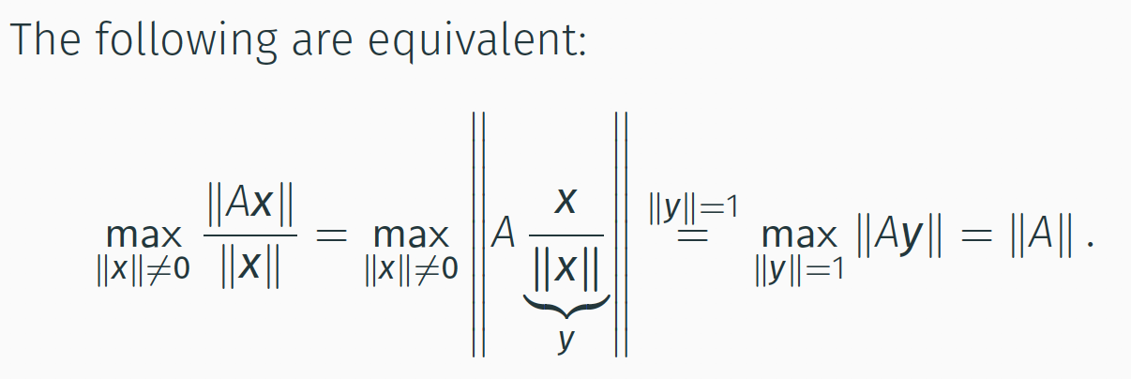
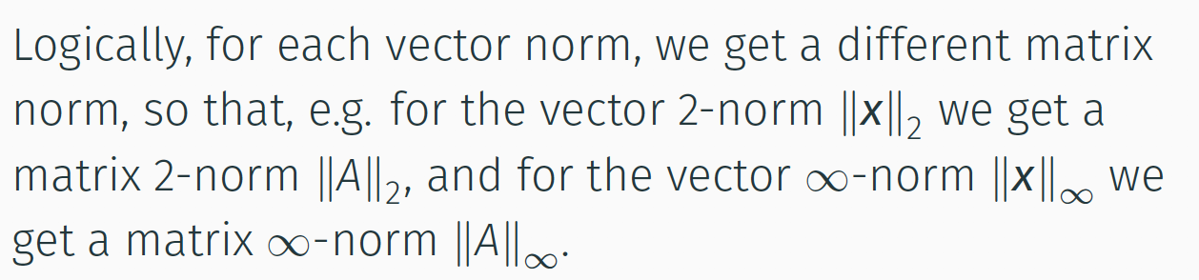
Matrix Norms

Slide 28
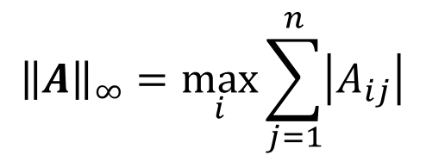
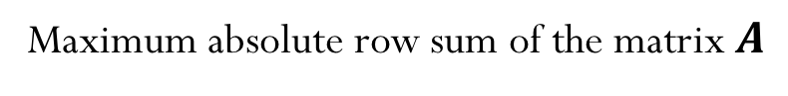
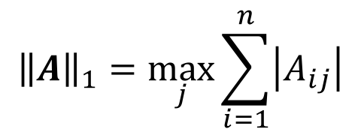



Induced Matrix Norms
$${\left\|A\right\|}_{1}=\max_{j}{\sum_{i=1}^{n}{\left|A_{ij}\right|}}$$
Maximum absolute column sum of the matrix $A$
$${\left\|A\right\|}_{∞}=\max_{i}{\sum_{j=1}^{n}{\left|A_{ij}\right|}}$$
Maximum absolute row sum of the matrix $A$
$${\left\|A\right\|}_{2}=\max_{k}{σ_{k}}$$
$σ_{k}$ are the singular value of the matrix $A$

Slide 29

Properties of Matrix Norms

Slide 30


Examples
Determine the norm of the following matrices:
1)
2)
Notes:
7
6

Slide 31


Slide 32


Slide 33


